Slide 1
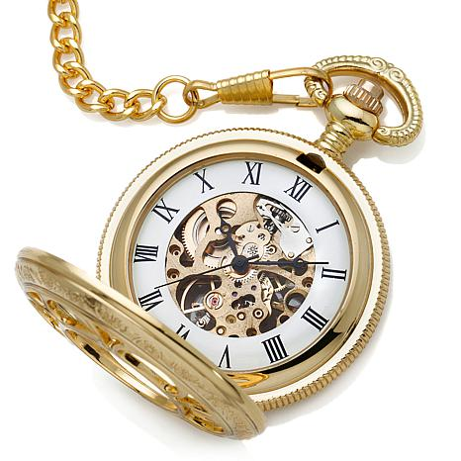
Timeline
Lecture Topics, Assignments, Project Milestones, Quizzes, and Exams

Slide 2
CSCI 4220
Week and Day | Section | Topic | Assignment | Due | Time
Week 1
day 1 | Introduction | Prelude (opening remarks)
 |  | Administrative Details |  |  | 38
 |  | Timeline
day 2 | Introduction | Language and Thought |  |  | 24
 |  | Machines |  |  | 27
Week 2
day 3 | Introduction | Programming Languages |  |  | 42
day 4 | Introduction | Computability |  |  | 61
Week 3
day 5 | Introduction | The Design of Java |  |  | 38
 |  | Installing the TL System |  |  | 11
 |  | Parenthesis Normal Form | A1 |  | 23
day 6 | Syntax | Basics of Context-Free Grammars |  | A1 | 34
 |  | Backus-Naur Form |  |  | 27

Slide 3
Week 4
day 7 | Syntax | Application |  |  | 32
 |  | Ambiguity and Parse Trees |  |  | 35
day 8 | Syntax | Expressions | Q1 |  | 38
 |  | Regular Expressions |  |  | 29
 |  | On-line Quizzes |  |  | 2
Week 5
day 9 | Syntax | RegEx Dialects | A2, M1 | Q1 | 16
 |  | A Look Back |  |  | 10
 |  | Overview of Assignment 2 |  |  | 5
 |  | Overview of Milestone 1 |  |  | 4
day 10 | Equational Reasoning | The Problem |  |  | 31
 |  | Term Languages |  |  | 17
 |  | Substitution |  |  | 11
 |  | Matching |  |  | 31
Week 6
day 11 | Equational Reasoning | Unification |  | A2 | 24
 |  | Equational Reasoning |  |  | 45
day 12 | Semantics | Program State |  |  | 22
 |  | An Algebraic Model of State |  |  | 14
 |  | Primitive Interactions |  |  | 24

Slide 4
Week 7
day 13 | Semantics | More Sophisticated Interactions |  | M1 | 25
 |  | Parameter Passing and Evaluation |  |  | 15
 |  | Parse Expressions |  |  | 25
day 14 | Review | Review of A2 |  |  | 22
 |  | Review of M1 |  |  | 29
Week 8
day 15 | Semantics | Matching with Parse Expressions | Q2 |  | 11
 |  | Denotational Semantics for Arithmetic Expressions |  |  | 24
 |  | Denotational Semantics for Imperative Language Constructs |  |  | 31
day 16 | Semantics | Scope | M2 | Q2 | 28
 |  | Type Checking |  |  | 15
 |  | A Denotational-style Type Checker |  |  | 11
 |  | Information Flow |  |  | 22
Week 9
day 17 | SML | Getting Started |  | M2 | 12
 |  | Basics |  |  | 21
day 18 | SML | Val Declarations |  |  | 24
 |  | Function Declarations |  |  | 20
 |  | Expression Sequences and Let-blocks |  |  | 9
class does
not meet

Slide 5
Week 10
day 19 | SML | A Look Back - Part 2 |  |  | 8
 |  | Recursion |  |  | 19
day 20 | Test (30%) | Exam 1
Week 11 | Spring Break
Week 12
day 23 | SML | Review of Exam 1 (Office Hours) | A3,M3 |  | 16
 |  | Overview of A3 |  |  | 1
 |  | Overview of M3 |  |  | 17
 |  | The Towers of Hanoi |  |  | 10
day 24 | SML | The Collatz Conjecture |  | A3 | 61
 |  | Lists |  |  | 16
class does
not meet

Slide 6
Week 13
day 25 | SML | Programming with Lists - Part 1 | A4 | M3 | 29
 |  | Programming with Lists - Part 2 |  |  | 34
day 26 | SML | Datatypes |  |  | 27
 |  | Structures |  |  | 7
 |  | The Standard Basis |  |  | 8
 |  | Modeling Program State |  |  | 24
Week 14
day 27 | SML | Review of A4 |  | A4 | 67
day 28 | SML | Overview of M4 | M4 |  | 27
 |  | Function values |  |  | 25
 |  | SOS | Q3 |  | 16
class does
not meet

Slide 7
class does
not meet
Week 15
day 29 | SML | Map and App |  | Q3 | 13
 |  | Fold |  |  | 17
 |  | Higher-order Examples |  |  | 17
day 30 | Test (20%) | Exam 2
Week 16 | Prep Week
day 31 | SML | Overview of Exam 3 |  |  | 2
 |  | Review of Q3 |  |  | 11
 |  | Tail Recursion |  |  | 19
 |  | Nameless Recursion |  |  | 7
day 32 | Test (10%) | Exam 3 |  | M4 (10%)
class does
not meet

Slide 8
The End

